Slide 1

Welcome
Agile, Scrum
Notes:
The Agile team is at the core of Agile software development, and its effectiveness heavily relies on collaboration, communication, and the ability to adapt to changing circumstances. Agile teams often work in close collaboration with stakeholders, including product owners, customers, and end-users, to deliver valuable software that meets user needs and expectations.

Slide 2
What is Agile?
Framework
Project Management Technique
Using JIRA for tickets
Methodology
“Feel good” industry hot trend
Software Development Process
Do “something” faster
Doing Daily Stand-up
Forming small teams
Notes:
Agile has gained widespread adoption in the software development industry due to its focus on delivering customer value, fostering collaboration, and enabling teams to respond effectively to changing requirements and market dynamics.
Agile methodologies, such as Scrum, Kanban, Extreme Programming (XP), and others, provide specific frameworks and practices for implementing the Agile principles. These methodologies offer processes for iterative development, regular inspection, and continuous improvement.

Slide 3



What is Agile?
Is a Mindset
Described & Defined by
Agile Manifesto (4 values & 12 principles)
Manifested through many practices
(Scrum, XP, Kanban, SAFe)
Agile is change in culture & values of an organization & its people
Notes:
Agile methodologies, such as Scrum, Kanban, Extreme Programming (XP), and others, provide specific frameworks and practices for implementing the Agile principles. These methodologies offer processes for iterative development, regular inspection, and continuous improvement.

Slide 4
How it all started?
All requirements are determined in the beginning
Product is designed, developed, and tested sequentially, with many handovers
The project fails or the customer doesn’t get what he/she really needs
Customer doesn’t really know what he/she wants
Often delivery is delayed and over budget
First working software late in the project—by then, many requirements have changed
12 months

Slide 5
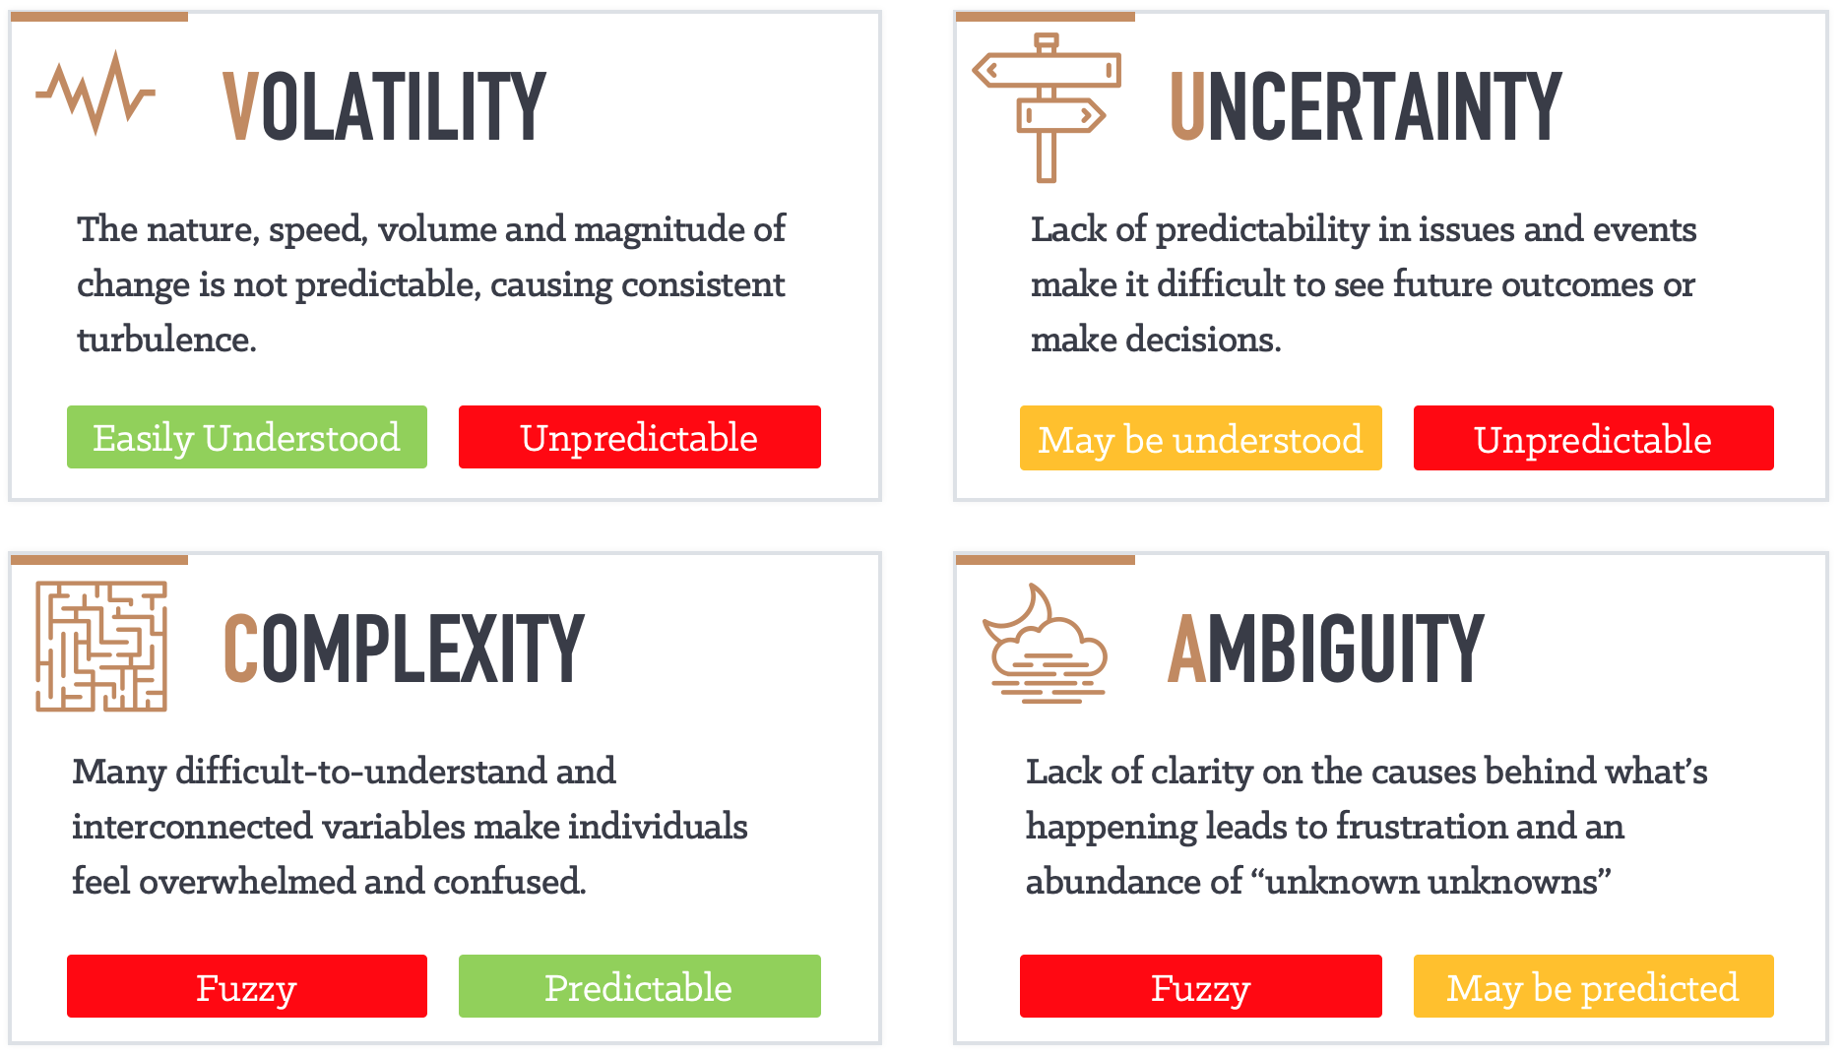
Another Dimension – VUCA world

Slide 6

Activity – Traditional vs Agile
Notes:
Activity: 10 minutes

Slide 7
Traditional vs Agile Approach
Traditional
Agile
Short, sharp cycles—able to change direction and react more quickly
Flexibility
Visibility
User engagement and frequent delivery—highly visible
Lower delivery risks through smaller but many deliveries to “release”
Delivery risk
Each cycle should deliver business benefit allowing early accrual
Business value

Slide 8
4 values - Agile Manifesto
We are uncovering better ways of developing software by doing it and helping others do it. Through this work we have come to value:
4 values of Agile Manifesto
Customer collaboration
Working software
Responding to change
Individuals and interactions
over
over
over
over
Contract negotiation
Comprehensive documentation
Following a plan
Processes and tools
Ambition: Create a culture of continuous improvement.
Notes:
The Agile Manifesto and its principles provide a foundation for Agile methodologies like Scrum, Kanban, and Extreme Programming (XP). These values and principles promote a customer-centric, flexible, and iterative approach to software development, resulting in the efficient delivery of valuable software that meets customer needs.

Slide 9
12 Principles of Agile
Early and Continuous Delivery of Valuable Software
Embrace Change
Deliver value often/Frequent Delivery
Business and Developers Together
Empower individuals
Rhythm for communication
Measure progress by working software
Use sustainable processes
Strive for excellence
Simplicity
Self-organizing teams
Regular Reflection and Adjustment
Principles behind the Agile Manifesto
Notes:
“Simplicity is the art of maximizing the work not done.” This idea is central to eliminating waste. To make your process more agile, do less. However, you can't take so much out of your process that it no longer works.

Slide 10
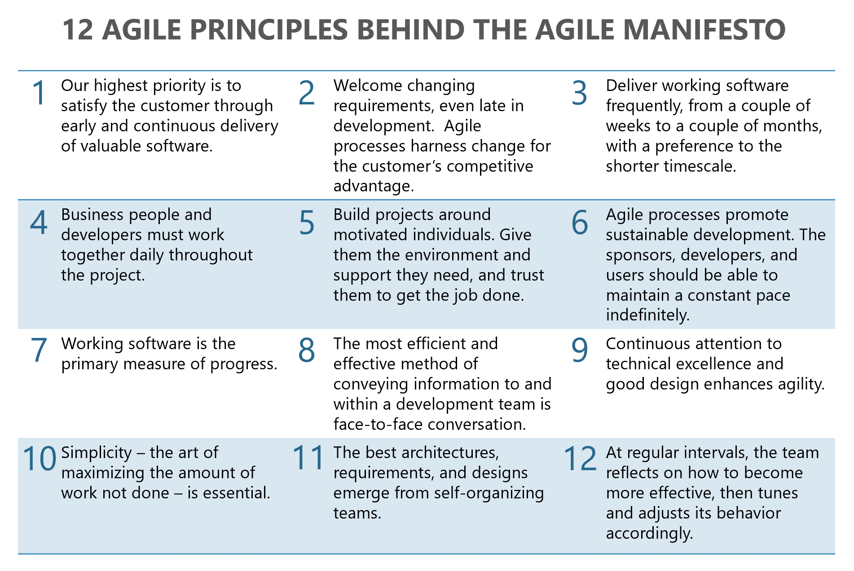
12 Principles - Agile Manifesto

Slide 11
Agile principles
Early and Continuous Delivery of Valuable Software: Our highest priority is to satisfy the customer through early and continuous delivery of valuable software.
Embrace Change: Welcome changing requirements, even late in development. Agile processes harness change for the customer's competitive advantage.
Deliver value often/Frequent Delivery: Deliver working software frequently, from a couple of weeks to a couple of months, with a preference to the shorter timescale.
Business and Developers Together: Business people and developers must work together daily throughout the project.

Slide 12
Agile principles
Empower individuals: Build projects around motivated individuals. Give them the environment and support they need, and trust them to get the job done.
Rhythm for communication: The most efficient and effective method of conveying information to and within a development team is face-to-face conversation.
Measure progress by working software: Working software is the primary measure of progress.
Use sustainable processes: Agile processes promote sustainable development. The sponsors, developers, and users should be able to maintain a constant pace indefinitely.

Slide 13
Agile principles
Strive for excellence: Continuous attention to technical excellence and good design enhances agility.
Simplicity: Simplicity--the art of maximizing the amount of work not done--is essential.
Self-organizing teams: The best architectures, requirements, and designs emerge from self-organizing teams.
Regular Reflection and Adjustment: At regular intervals, the team reflects on how to become more effective, then tunes and adjusts its behaviour accordingly.

Slide 14
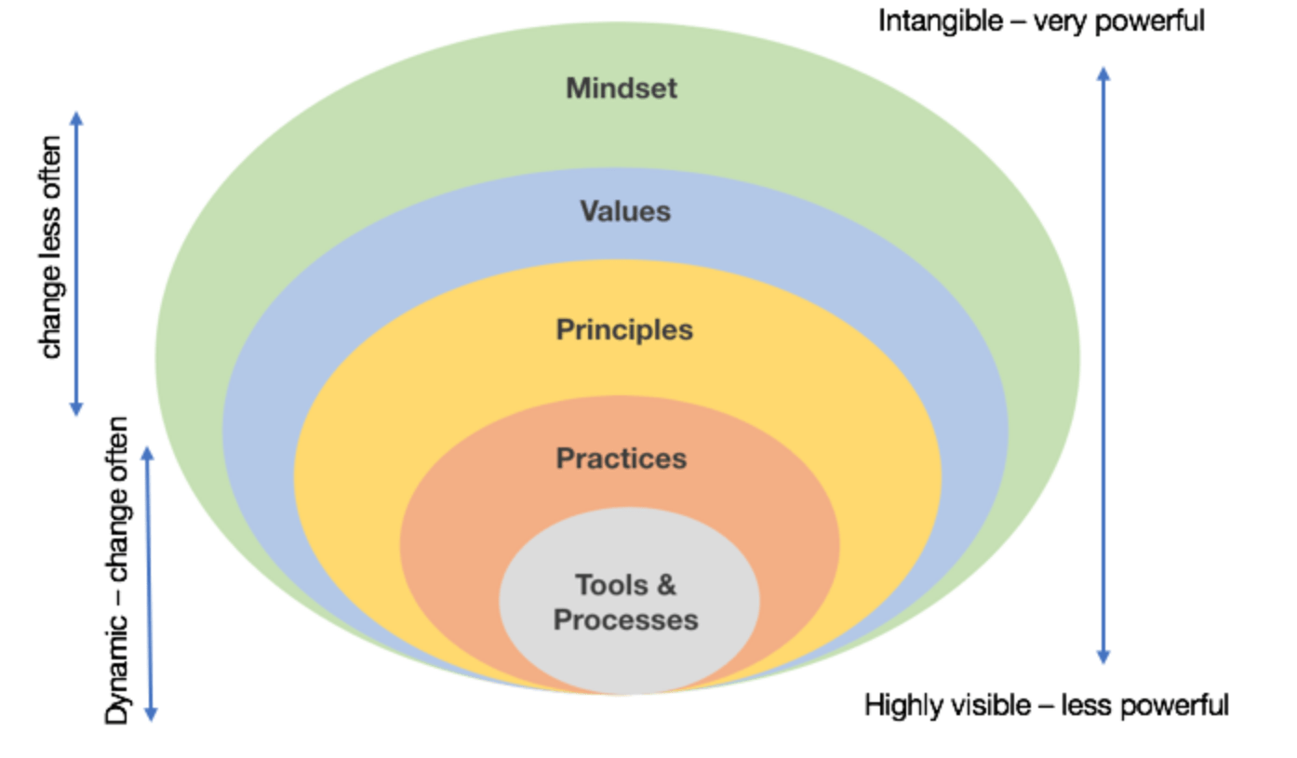
Being Agile vs Doing Agile
Organization Culture, People Behavior
Being Agile
Agile Manifesto
Scrum XP, Kanban
Doing Agile
Jira, Azure, DevOps
Notes:
"Being Agile" and "Doing Agile" are two different perspectives that reflect how an organization or team approaches Agile principles and practices. These concepts highlight the difference between embracing the Agile mindset as part of the organizational culture ("Being Agile") and simply following Agile practices without fully understanding the underlying principles ("Doing Agile").
Being Agile: "Being Agile" goes beyond adhering to Agile practices and methodologies. It involves adopting the Agile mindset and values, which include collaboration, adaptability, customer focus, and continuous improvement. When an organization or team is truly "being Agile," they internalize these values and incorporate them into their culture and decision-making processes. It's about understanding the why behind Agile practices and adapting them to fit the unique needs of the organization. Characteristics of "Being Agile" include:
Embracing a culture of collaboration and openness.
Prioritizing customer needs and delivering value.
Encouraging continuous learning and improvement.
Focusing on outcomes rather than just outputs.
Adapting to change and uncertainty.
Doing Agile: "Doing Agile" refers to the act of following Agile practices and methodologies without necessarily embodying the Agile values and mindset. In this scenario, teams might implement Agile practices because they are mandated or perceived as a trend, rather than truly understanding their purpose and value. While this approach might yield some benefits, it may not lead to the full potential of Agile's advantages. Characteristics of "Doing Agile" include:
Following Agile practices by the book without considering their context.
Relying on a prescriptive approach rather than adapting to the organization's needs.
Prioritizing processes and rituals over collaboration and outcomes.
Focusing on adhering to a specific methodology without understanding its principles.
Viewing Agile as a set of tools rather than a mindset shift.
In essence, "Being Agile" reflects a deeper cultural shift that extends beyond processes and methodologies. It involves embracing Agile principles and values as part of the organization's DNA, which then influences decision-making, collaboration, and how work is approached. "Doing Agile," on the other hand, focuses primarily on the tactical implementation of Agile practices without necessarily cultivating the underlying mindset.
Organizations that successfully "be Agile" are more likely to experience the full benefits of Agile methodologies, including improved collaboration, faster delivery, increased customer satisfaction, and adaptability to changing circumstances.

Slide 15
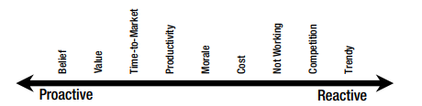
Common Motivators For Moving To Agile
Notes:
Organizations consider transitioning to Agile methodologies for various reasons, driven by the potential benefits and outcomes that Agile practices offer. Some common motivations for moving to Agile include:
Belief
Value
Time to market
Productivity
Morale
Cost
Not working
Completion
Trendy
Ultimately, the decision to move to Agile should align with an organization's specific context, challenges, and goals. It's important to recognize that while Agile offers numerous benefits, successful adoption requires a commitment to cultural change, training, and continuous improvement.

Slide 16
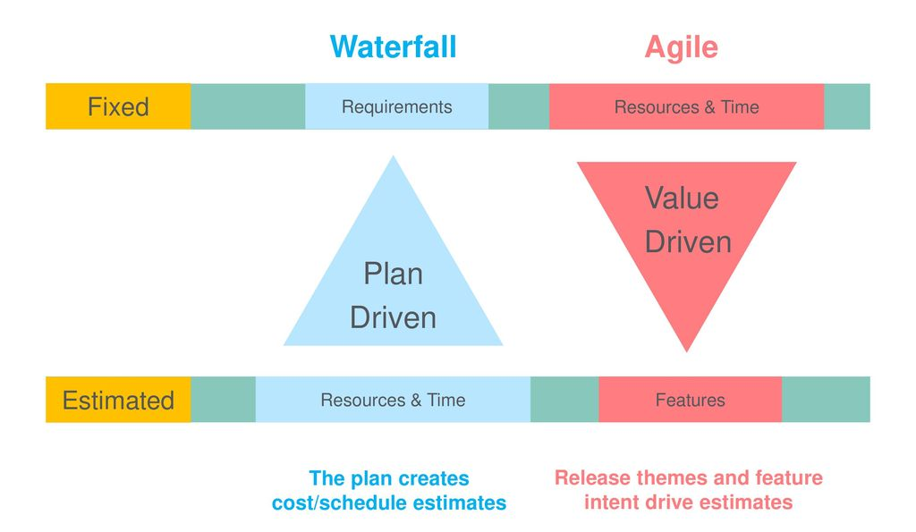
Agile vs Waterfall – A Change in Philosophy

Slide 17
/reads/agile-manifesto
github.com/the-code-camp/stem-sdlc/
Notes:
https://github.com/the-code-camp/stem-sdlc/blob/main/reads/agile-manifesto/The_Agile_Manifesto.pdf

Slide 18
Activity: Cohort collaboration
Join a breakout room with your cohort
Every group will be assigned one principle. Read the manifesto document
Embrace Change (2)
Deliver value often/Frequent Delivery (3)
Strive for excellence (9)
Simplicity (10)
Regular Reflection and Adjustment (12)
You need to discuss and brainstorm examples of how that value can be demonstrated in an Agile team.
Each group presents their findings to the larger group. Select a member to present
Notes:
Activity: 20 minutes

Slide 19

Scrum

Slide 20
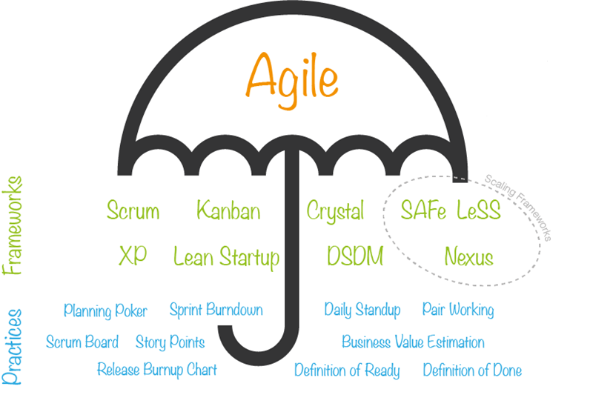
Agile Umbrella
Agile is an umbrella term for a set of methods and practices based on the values and principles expressed in the Agile Manifesto that is a way of thinking that enables teams and businesses to innovate, quickly respond to changing demand, while mitigating risk.
Notes:
The term "Agile Umbrella" is not a widely recognized term or concept in the Agile methodology. However, based on the context, it might refer to the idea that Agile principles and practices can provide a unifying framework or "umbrella" under which various Agile methodologies, practices, and frameworks can be grouped.
Agile itself is not a single methodology but a set of guiding principles and values that promote iterative and incremental software development, collaboration, customer-centricity, and adaptability. Under this Agile "umbrella," various Agile methodologies and frameworks have been developed, each offering specific practices and guidelines for implementing Agile principles effectively.
Scrum: A widely used Agile framework that emphasizes iterative development in short time periods called sprints. It includes roles like Scrum Master and Product Owner, as well as ceremonies like daily stand-ups and sprint reviews.

Slide 21
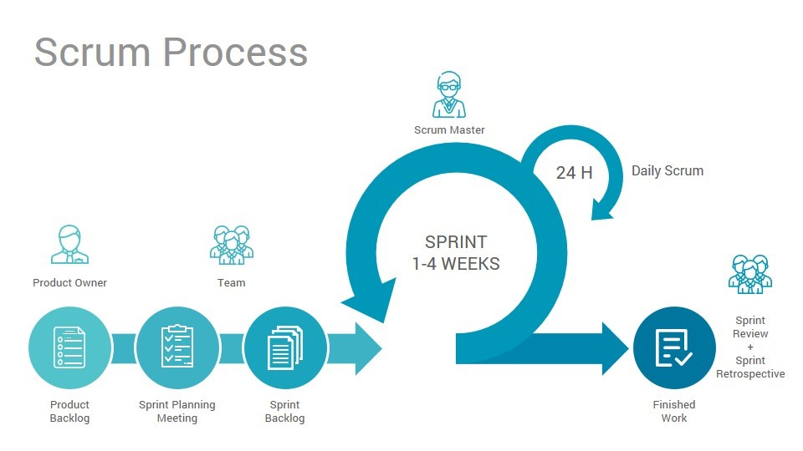
Scrum Overview
Scrum (n): An empirical framework within which people can address complex adaptive problems, while productively and creatively delivering products of the highest possible value
– Scrum.org
Scrum is:
Lightweight
Simple to understand
Difficult to master
Potentially Shippable Product Increment
Notes:
Scrum promotes a customer-centric approach by prioritizing the most valuable features and delivering them early and frequently. It provides a framework for continuous feedback, enabling teams to adapt to changing requirements and deliver high-quality software. Scrum's transparent approach ensures that stakeholders have visibility into the project's progress and impediments, fostering effective collaboration.

Slide 22
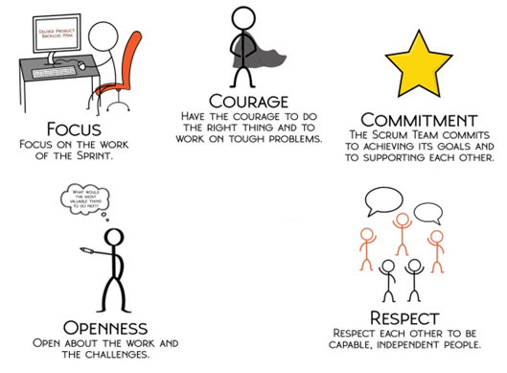
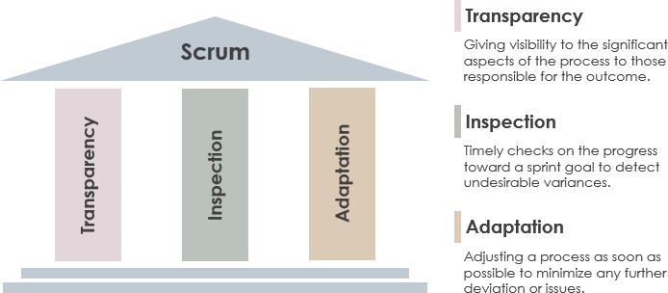
Scrum – Pillars & Values
3 Pillars
5 Values

Slide 23
Scrum: 3-5-3
3
Roles
Product Owner
Team/Agile team
Scrum Master
5
Events
Sprint Planning
Sprint
Daily Scrum/Stand-up
Sprint Review/ Demo
Sprint Retrospective
Backlog Refinement
3
Artifacts
Product Backlog
Sprint Backlog
Potentially Shippable Product Increment
Backlog Refinement*
Potentially Shippable Product Increment

Slide 24
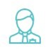
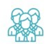

Scrum Roles
Accountable for maximizing the value of the product resulting from the work of the Scrum Team.
Product backlog management & prioritization; owns product backlog, i.e., single authority on product backlog
Developing & communicating product goal & vision.
Ensuring Product Backlog is visible, transparent and understood
Is a one person; not a committee.
Product Owner
Developers/Team are the people on agile/scrum team that are committed to creating any aspect of a usable Increment each sprint.
Creates a plan for the Sprint, the Sprint Backlog.
Instilling quality by adhering to a Definition of Done.
Adapting their plan each day toward the Sprint Goal.
Holding each other accountable as professionals.
Developers/Team
True leaders (servant-leaders) who serve the Scrum Team and the larger organization.
Responsible for the Scrum Team’s effectiveness.
Ensuring that all Scrum events take place and are positive, productive, and kept within the timebox.
Causing the removal of impediments to the Scrum Team’s progress.
Helping find techniques for effective Product Goal definition and Product Backlog management.
Leading, training, and coaching the organization in its Scrum adoption.
Scrum Master
Notes:
In Scrum, the Product Owner is a key role responsible for representing the interests of the stakeholders and ensuring that the development team delivers maximum value to the customers and end-users. The Product Owner plays a crucial role in defining the product vision, prioritizing the work to be done, and providing clear requirements and feedback to the development team. They act as the bridge between the stakeholders and the development team, ensuring that the software meets the needs of the users and aligns with the business goals.
It is important to note that the Scrum Master is not the team's manager or decision-maker. They facilitate the team's self-organization and decision-making processes. The Scrum Master collaborates with the Product Owner and the Development Team to ensure that Scrum practices are followed and that the team remains focused on delivering value to customers.
In Scrum, stakeholders are individuals or groups who have an interest in the project's outcome or can influence its success. They play a crucial role in providing feedback, setting priorities, and defining the requirements for the product being developed. Stakeholders are actively involved throughout the development process to ensure that the final product meets their needs and expectations.

Slide 25

Scrum Events – The Sprint
Heartbeat of Scrum
Has a goal
Fixed length events for consistency
During the sprint
Everyone focuses on sprint goal
Quality is consistent
Product backlog is refined
Clarifications Re-negotiations happens
Timeboxed – 1- 4 weeks
All other events happen within the sprint
Notes:
In Agile software development, a "sprint" refers to a time-boxed period during which a development team works on a set of predefined tasks or user stories. Sprints are a fundamental concept in methodologies like Scrum, which is a popular Agile framework.
Sprints provide a structured and manageable way to deliver value incrementally and iteratively. They allow teams to adapt to changing requirements, receive frequent feedback, and make continuous improvements. Sprints provide a predictable rhythm to the development process and help manage work in a way that balances flexibility with predictability.

Slide 26

Scrum Events – Sprint Planning
Initiates the sprint
Outcomes are:
Sprint Goal
Sprint Backlog
Addresses the following:
Why is sprint valuable?
What can be done in this Sprint?
How will the work get done?
Timeboxed – Max. 2 hours per week of sprint

Slide 27
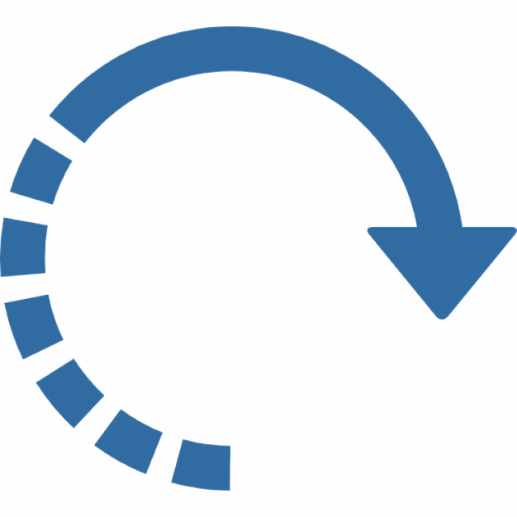
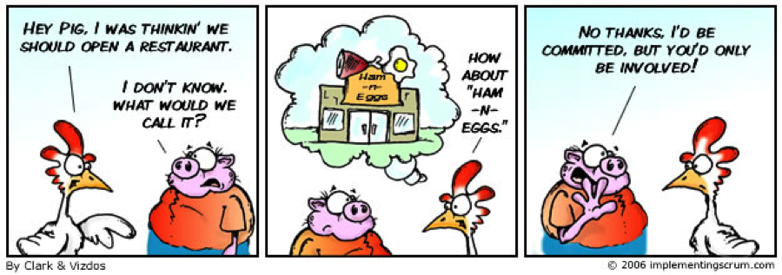
Scrum Events – Daily Scrum
Inspect progress towards sprint goal
Adjust the unplanned work
15-minute event for the complete team
Improves communication
Identify Impediments
Promotes quick decision making
Timeboxed – 15 minutes daily
Notes:
The Daily Scrum, also known as the Daily Stand-up or Daily Standup Meeting, is a key practice within Agile methodologies, particularly in frameworks like Scrum. It's a short and focused daily meeting where members of a development team gather to synchronize their work, discuss progress, and plan their activities for the day. The primary goal of the Daily Scrum is to promote transparency, communication, and collaboration within the team.
The Daily Scrum serves as a valuable practice for keeping the team aligned, informed, and focused on the project's goals. By providing a forum for quick updates and removing potential roadblocks, the team can make decisions and adapt to changes in a timely manner.

Slide 28

Scrum Events – Sprint Review
Inspect the outcome of the Sprint.
Team presents the results of work to key stakeholders and PO
May result in adjustment of Product Backlog
Is a working session, avoid presentations
Timeboxed – Max. 1 hour per week of sprint
Notes:
The Sprint Review is a crucial ceremony within Agile methodologies, particularly in frameworks like Scrum. It occurs at the end of each sprint and serves as an opportunity for the development team to showcase the work they've completed during the sprint to stakeholders, receive feedback, and ensure that the increment of the product aligns with expectations.

Slide 29

Scrum Events – Sprint Retrospective
Plan ways to increase quality & effectiveness
Primary discussion is :
What went well?
Problems encountered
How problems were (were not) solved?
Most impactful improvement(s) are identified & added to product backlog
Last event and concludes the sprint
Timeboxed – Max. 1 hour per week sprint

Slide 30

Backlog Refinement/Grooming
What is backlog refinement/grooming?
Add detail, estimates and order to user stories
Refining involves 3 actions:
Making it easier to understand
Making it small enough to complete in one sprint
Adding acceptance criteria which define when the story is complete
Refined stories from the input for the next “sprint planning”
Why do we do backlog refinement?
To ensure common understanding of the stories.
Develop a view on what needs to be delivered 2-3 sprints ahead to have confidence
Notes:
Backlog Refinement, also known as Backlog Grooming, is a practice in Agile methodologies, particularly in Scrum, that involves regularly reviewing, refining, and preparing items in the product backlog for upcoming sprints. The goal of backlog refinement is to ensure that the backlog contains well-defined, properly prioritized, and actionable items that are ready for the development team to work on.

Slide 31
Backlog Refinement/Grooming
Who participates?
Team members to clarify stories
Product Owner to prepare stories and facilitate discussion
Scrum Master to ensure right practices are followed and observer behavior
Relevant Subject Matter Expertise (SME)

Slide 32
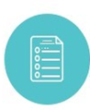


Scrum Artifacts
Is an emergent, ordered list of what is required or needs to be done in a product.
Product Backlog Refinement/Grooming is the act of breaking larger items to small precise items.
Team does the sizing of product backlog items (PBIs).
Single ownership by Product Owner to prioritize and enhance.
Product goal is in the product backlog. The rest of the Product Backlog emerges to define “what” will fulfill the Product Goal.
Product Backlog
Developers/Team are the people on agile/scrum team that are committed to creating any aspect of a usable Increment each sprint. Accountable for:
Creating a plan for the Sprint, the Sprint Backlog.
Instilling quality by adhering to a Definition of Done.
Adapting their plan each day toward the Sprint Goal.
Holding each other accountable as professionals.
Sprint Backlog
A concrete stepping stone towards the product goal.
Each increment is additive to all prior increments.
Thoroughly verified (through various testing techniques) ensuring all increments work together.
Increment must be usable to provide value.
Multiple increments may be created within a sprint.
Potentially Shippable Product Increment

Slide 33


Sprint – How it all works together?
1- 4 weeks
Sprint
Daily Scrum
Design
Sprint End - Last Day
Sprint Start - Day 1
Code/
Refactor
Iterative Process
Product Backlog
Sprint Planning
Build/
Deploy
Sprint Review
Potentially
Shippable
Product
Increment
Sprint Retrospective
Sprint Goal + Sprint Backlog
Backlog Refinement
Test

Slide 34

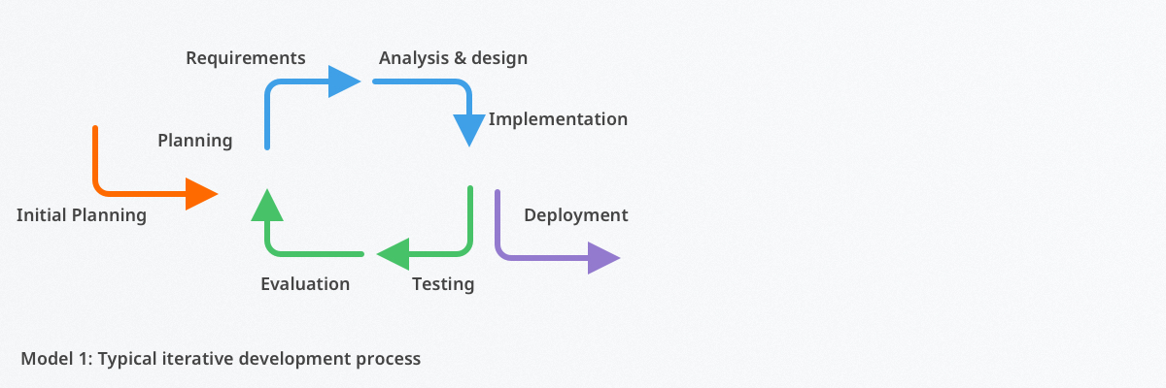
Iterative Process
Breaks down large tasks into smaller pieces that can be repeated, refined, and researched throughout the software development cycle.
Also called as PDCA model:
P (Plan) – Iteration planning focuses on the planning and discussion of requirements and objectives of an iteration/sprint.
D (Design) – Iteration implementation is concerned with the analysis, design, and implementation of projects. The team develops & tests software during this phase of the cycle.
C (Check) – Iteration testing is concerned with ensuring the deliverable meets project requirements. If certain criteria are not met, the team can move backward to the other phases for further improvements.
A (Adjust) – Iteration evaluation means comprehensively reviewing the work of the iteration or cycle. The software development team will also refine its backlog to prepare for future iterations.
Notes:
Also called as PDCA model:
P (Plan) – Iteration planning focuses on the planning and discussion of requirements and objectives of an iteration/sprint.
D (Design) – Iteration implementation is concerned with the analysis, design, and implementation of projects. The team develops & tests software during this phase of the cycle.
C (Check) – Iteration testing is concerned with ensuring the deliverable meets project requirements. If certain criteria are not met, the team can move backward to the other phases for further improvements.
A (Adjust) – Iteration evaluation means comprehensively reviewing the work of the iteration or cycle. The software development team will also refine its backlog to prepare for future iterations.

Slide 35
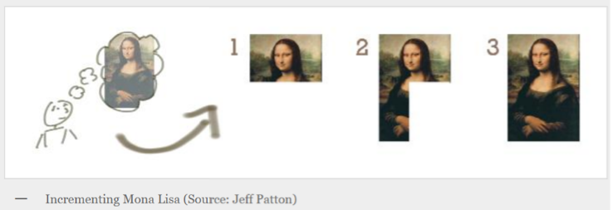
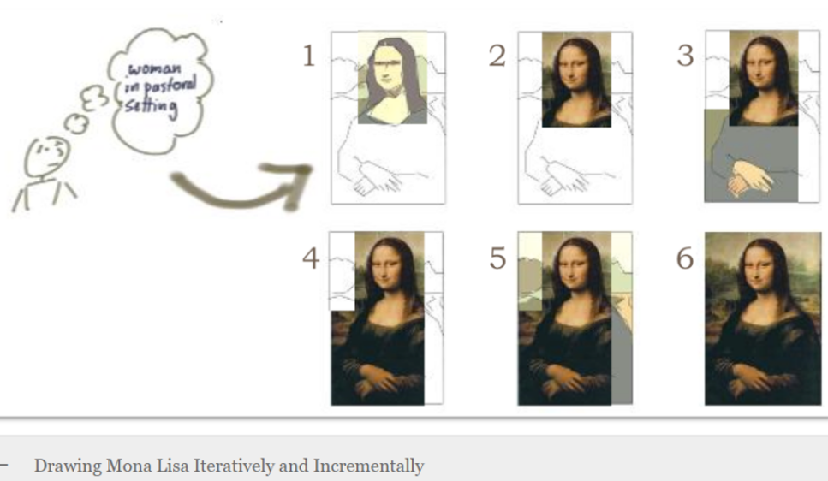
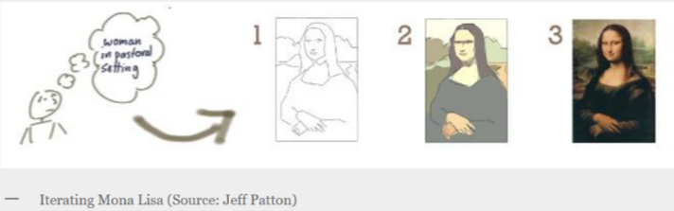
Iterative or Incremental

Slide 36




Thank you!
Notes:
Mandatory -- Need bookend -- first and last thing they should see is DevelopIntelligence
ACTION: Use this for the final slide of your class materials.

